Slide 1
Biomedical/ Healthcare NER & Relation Extraction
(Thanks to Shweta Yadav)

Slide 2
Tools for Biomedical Entity Extraction
MetaMap (2001), Apache cTakes (2010) : traditional architectures
Sentence boundary detector
Tokenizer
Normalizer
Part-of-speech (POS) tagger
Shallow parser
Named entity recognition (NER) annotator, including status and negation annotators.
MedSpacy
Various versions of LLMs
Aronson. Effective mapping of biomedical text to the UMLS Metathesaurus: the MetaMap program. AMIA Annual Symposium Proceedings, 2001.
H. Eyre, A. Chapman, K. Peterson, J. Shi, P. Alba, M. Jones, T. Box, S. DuVall, O. Patterson. Launching into clinical space with medspaCy: a new clinical text processing toolkit in Python. AMIA Annual Symposium Proceedings, 2022.
G. Savova, J. Masanz, P. Ogren, J. Zheng, S. Sohn, K. Kipper-Schuler, C. Chute. Mayo clinical Text Analysis and Knowledge Extraction System (cTAKES): architecture, component evaluation and applications. Journal of the American Medical Informatics Association, 2010.
cTakes code

Slide 3
Event Extraction from Unstructured Clinical Notes
with cTAKES^{[1]}
extracts clinical concepts from text
maps synonymous concepts to unique identifiers (CUI) in UMLS^{[2]} clinical knowledge graph
Patient with a history of diabetic foot and foot checkup. Patient states the toenails are thick, elongated, unable to trim on her own. Patient denies any recent history of trauma. Debrided nails today.
ANATOMY DISEASE/DISORDER SIGN/SYMPTOM MEDICATION
[1] Savova et al. “Mayo clinical text analysis and knowledge extraction system (ctakes): architecture, component evaluation and applications,” JAMIA. 2010.
[2] Bodenreider "Using UMLS semantics for classification purposes." AMIA Symposium. 2000.

Slide 4
UMLS: Unified Medical Language System
2026AA Release
18M Names
3.5M Concepts
9.3M Codes
31 Languages (including Italian)
195 Vocabularies
NLM. UMLS Reference Manual. Technical report, National Library of Medicine, September2009. http://www.ncbi.nlm.nih.gov/books/NBK9676/

Slide 5
UMLS consists of
SPECIALIST
Lexicon & Tools
Metathesaurus
Semantic Network
1 million+
biomedical concepts from over 100 sources
135 broad categories and 54 relationships between categories
lexical information and programs for language processing
3 Knowledge Sources
used separately or together
Slides courtesy of NLM, NLM-UMLS
Notes:
The Unified Medical Language System brings together 3 very different components, called Knowledge Sources.
They are:
the Metathesaurus,
the Semantic Network and
the SPECIALIST Lexicon and Lexical Tools.
The first Knowledge Source is the Metathesaurus, which is a very large, multi-purpose, multi-lingual vocabulary database.
It contains information on more than 1 million biomedical and health-related concepts from over 100 vocabularies, terminologies and code sets in 17 languages.
The 2nd Knowledge Source, the Semantic Network, is a set of broad subject categories, called Semantic Types, and a set of useful relationships between them, called Semantic Relationships.
Semantic Types are assigned to Metathesaurus concepts, and are part of the information included in the Metathesaurus about each concept.
Semantic Types provide a consistent categorization of all concepts represented in the UMLS Metathesaurus.
The SPECIALIST Lexicon contains lexical information for over 300 thousand common English words and biomedical vocabulary. This lexical information can be used with the SPECIALIST Natural Language Processing (NLP) tools, or programs, to process vocabularies, text and natural language.
The 3 UMLS Knowledge Sources may be used separately or together, depending on the needs of the application. For example, at NLM, both the Semantic Network and the SPECIALIST Lexicon and tools are used in the production of the Metathesaurus. The Semantic Network is used to categorize the terms in the Metathesaurus for the assignment of Semantic Types and other processing. Lexical tools are used to normalize terms when adding or updating sources in the Metathesaurus, and to create indexes that are distributed with the Metathesaurus.

Slide 6
UMLS Objectives
Intellectual middleware
A set of multi-purpose tools for system developers
Knowledge Sources used to overcome:
disparities in language and language format Ex: atrial fibrillation, auricular fibrillation, af
disparities in granularity and perspective Ex: Contusions, hematoma, bruise
Ex: Instruct patient to promptly report nosebleeds and excessive bruising (NIC), Epistaxis (MeSH)
Notes:
The UMLS was designed for use by systems developers. It is not an end-user product.
The goal of the project was to develop a set of multi-purpose tools that could be used by developers to enhance the interpretation and understanding of medical meaning across systems in a wide variety of applications.
These tools were designed to help improve the retrieval of machine-readable information across systems, and in particular, to overcome the variety of ways that the same concepts are expressed in machine-readable and human language in different systems.

Slide 7
Metathesaurus: clusters terms by meaning
Concepts contain synonymous terms
Preferred term is chosen (default can be changed)
Unique identifier (CUI) is assigned
term source term type source ID
Addison’s disease Metathesaurus PN
Addison’s disease SNOMED CT PT 363732003
Addison’s Disease MedlinePlus PT T1233
Addison Disease MeSH PT D000224
Bronzed disease SNOMED Intl SY DB-70620 Primary Adrenal Insufficiency MeSH EN D000224
Primary hypoadrenalism MedDRA LT 10036696
syndrome, Addison
C0001403
Addison’s disease
Notes:
How does the Metathesaurus work?
First, synonymous terms from the source vocabularies are gathered into a single concept.
In this example you see five terms that reference the same meaning, or concept, despite different spellings and words.
Synonymous terms are organized into a concept, and a meaningless unique identifier, called concept unique identifier or “CUI” is assigned.
In the example the CUI is C0001403, the number on the bottom of the screen. A preferred term among all terms in the concept is selected by NLM by default, but can be altered to suit the user’s needs. In this example the preferred term is ‘Addison’s disease’ listed on the bottom of the slide. Preferred terms are set by users when they create a subset.
Despite this manipulation, all source information is preserved. The source of the term, the type of term, and term identifier from the source as listed in the center of the slide are still present in the Metathesaurus.

Slide 8
Organization of Concepts
S0011231 Adrenal Gland Disease
A0020266 MeSH A7568579 NCI Thesaurus
S0000441 Disease of adrenal gland
A0001264 SNOMED 1982
A6917004 SNOMED Clinical Terms
S0481705 Diseases of Adrenal Gland
A0014499 SNOMED 1982
S0220090 Diseases, adrenal gland
A0049924 MeSH
Term
L0001621
[…]
Concept
C0001621
S0632950 Disorder of adrenal gland A0688820 Read Codes
A4778687 SNOMED Clinical Terms
S0354509 Adrenal Gland Disorders
A6996540 MedlinePlus
A7576253 NCI Thesaurus
A7561794 Psychological Index Terms
Term
L0181041
Term
L1279026
S1520972 Nebennierenkrankheiten
A7500884
Notes:
Term = normalized string
LUI = lexical unique identifier

Slide 9
Semantic Network
135 Semantic Types
Broad subject categories (Clinical Drug, Virus)
Ex:
Addison’s Disease
Semantic Type: Disease or Syndrome
54 Semantic Relationships
Links between categories (isa, causes, treats)
Ex:
Virus causes Disease or Syndrome
Types + Relationships
Form the structure of the semantic network
Broadly categorize the biomedical domain
Notes:
The UMLS Semantic Network consists of 135 Semantic types, or broad categories, arranged in hierarchies, and 54, useful and plausible relationships that can exist between them, called Semantic Relationships.
Semantic Types are organized into 2 hierarchies, Entity and Event.
Semantic relationships include the ‘isa’ relationship that is used to build hierarchical structures, as well as associative relationships arranged in five small hierarchies.
The Semantic Network provides a structure to the terms in the Metathesaurus, which has no overall hierarchy.
It can also be used to filter terms in the Metathesaurus for processing, or for defining useful subsets of needed terms. For example, a subset might contain only Disease concepts or only concepts that have a Semantic Type of “plant.”

Slide 10
54 Semantic Relationships
Hierarchical (isa = is a kind of)
among types
Animal isa Organism
Enzyme isa Biologically Active Substance
among relationships
prevents isa affects
Non-hierarchical
Sign or Symptom diagnoses Pathologic Function
Pharmacologic Substance treats Pathologic Function

Slide 11
Semantic Network Relationships
Organism
process of
part of
property of
evaluation of
Biologic
Function
Finding
evaluation of
Organism
Attribute
Anatomical
Structure
Laboratory or
Test Result
Sign or
Symptom
disrupts
Physiologic
Function
Pathologic
Function
disrupts
Injury or
Poisoning
location of
Embryonic
Structure
Anatomical
Abnormality
Fully Formed
Anatomical
Structure
co-occurs with
conceptual
part of
Congenital
Abnormality
Acquired
Abnormality
conceptual
part of
contains, produces
Body Location
or Region
conceptual
part of
Body System
Body
Substance
Body Space
or Junction
adjacent to
conceptual
part of
Body Part, Organ or
Organ Component
Tissue
Cell
Cell
Component
Gene or
Genome
location of
part of
part of
part of
part of
Notes:
Graphic shows richness of relationships, both hierarchical and associative
Not an ontology
Used to describe and classify the meta
Not evenly granular

Slide 12
Why have a Semantic Network?
Semantic Types
High level categories assigned to Metathesaurus concepts
Independent of position in source hierarchies
Semantic Relations
Useful links between Semantic Types
Relationships may hold at the concept level
Other relationships may apply at the concept level

Slide 13
Common Biomedical Relation Extraction Tasks
Protein-protein interaction
Chemical-protein interaction
Gene-disease relations
Chemical-disease relations

Slide 14
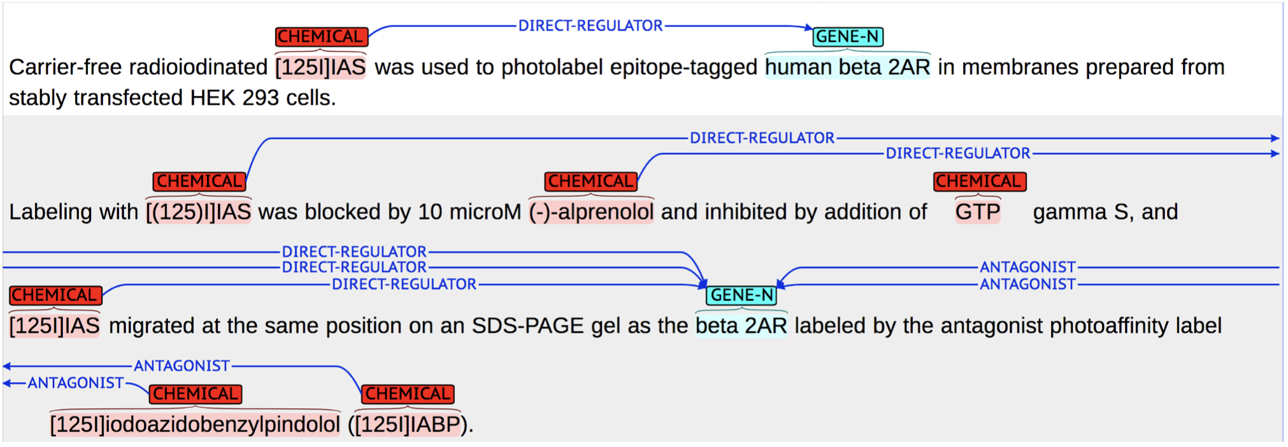
Chemical-protein interactions (CHEMPROT)
Aim: To automatically detect relations between chemical compounds/drug and genes/proteins.
Taboureau O, Nielsen SK, Audouze K, Weinhold N, Edsgärd D, Roque FS, Kouskoumvekaki I, Bora A, Curpan R,
Jensen TS, Brunak S, Oprea TI. ChemProt: a disease chemical biology database. Nucleic Acids Res. 2011

Slide 15
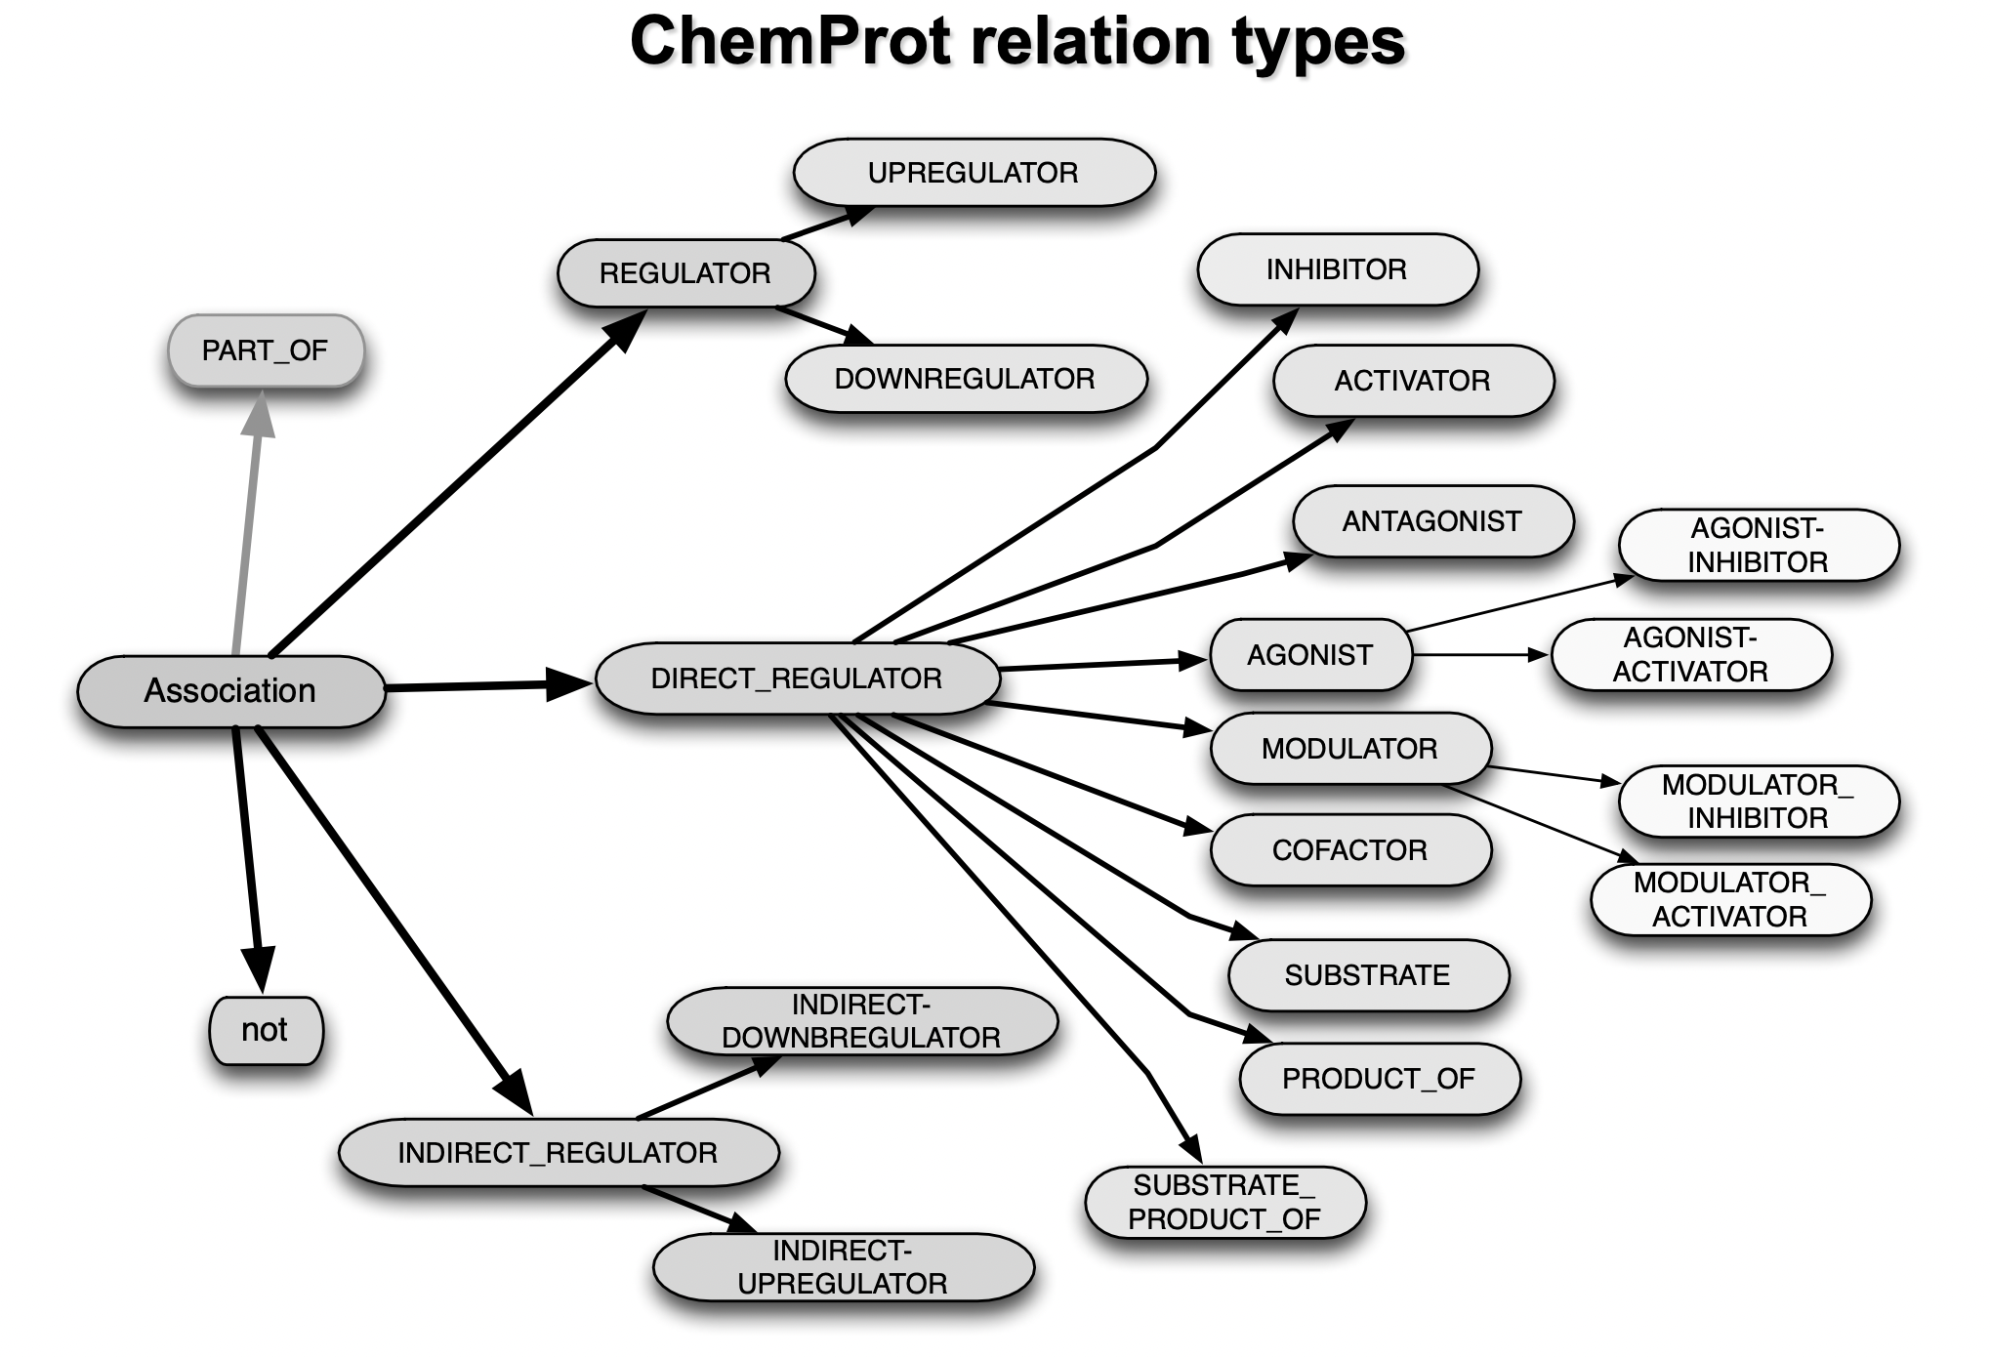

Slide 16
Medical Relation Extraction
Medical problem - treatment relations:
Treatment improves medical problem
hypertension was controlled on hydrochlorothiazide.
Treatment worsens medical problem
tumor was growing despite the available chemotherapeutic regimen
Treatment causes medical problem
Bactrim could be a cause of these abnormalities
Treatment is administered for medical problem
Lasix periodically to prevent him from going into congestive heart failure
Treatment is not administered because of medical problem
Relafen which is contraindicated because of ulcers
Medical problem - test relations
Medical problem - medical problem relations

Slide 17
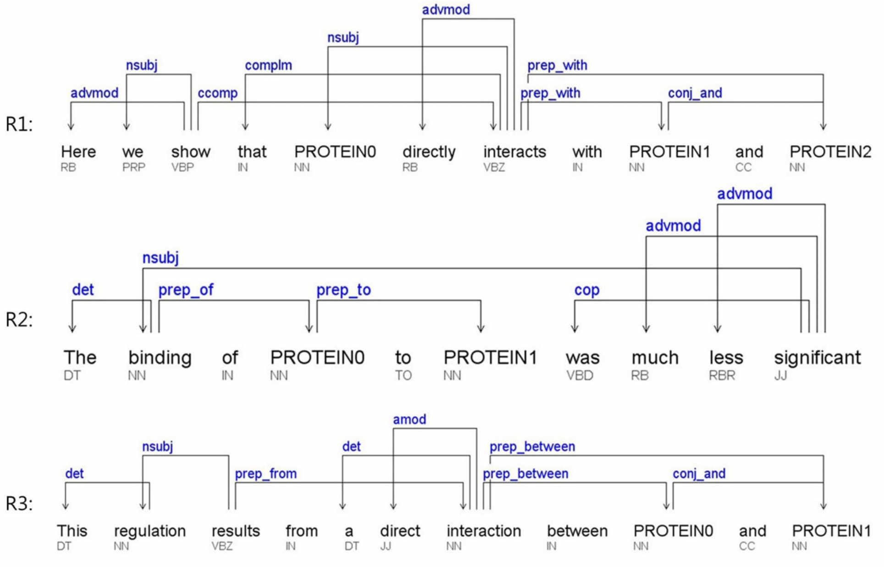
Existing Work on Biomedical Relation Extraction
Rule-based
Rule 1: Pi - REL – Pj
Rule 2: REL - of - Pi - PREP – Pj
Rule 3: REL - {between, of} - Pi - and – Pj
Not realistic!
Long-distance relations in complex sentences are typically prone to parsing errors.
Ref: Lee, J., Kim, S., Lee, S., Lee, K., & Kang, J. (2013, April). On the efficacy of per-relation basis performance evaluation for PPI extraction and a high-precision rule-based approach. In BMC medical informatics and decision making (Vol. 13, No. 1, pp. 1-12). BioMed Central.

Slide 18
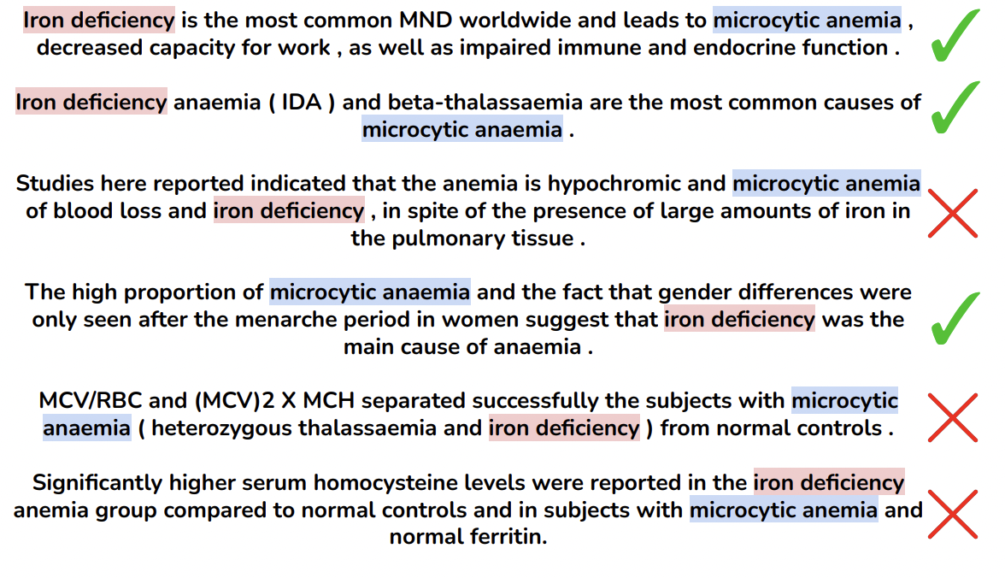
Existing Work on Biomedical Relation Extraction- Supervised Learning
Idea: label examples, train a classifier (SVM, Naïve bayes, CRF)
Success! Better generalizability Problem: require feature engineering:-(

Slide 19
Features
Semantic features
path between the two entities in the dependency parse
Syntactic features
the entities themselves
the types of the two entities
word sequence between the entities
number of words between the entities
path in the parse tree containing the two entities

Slide 20
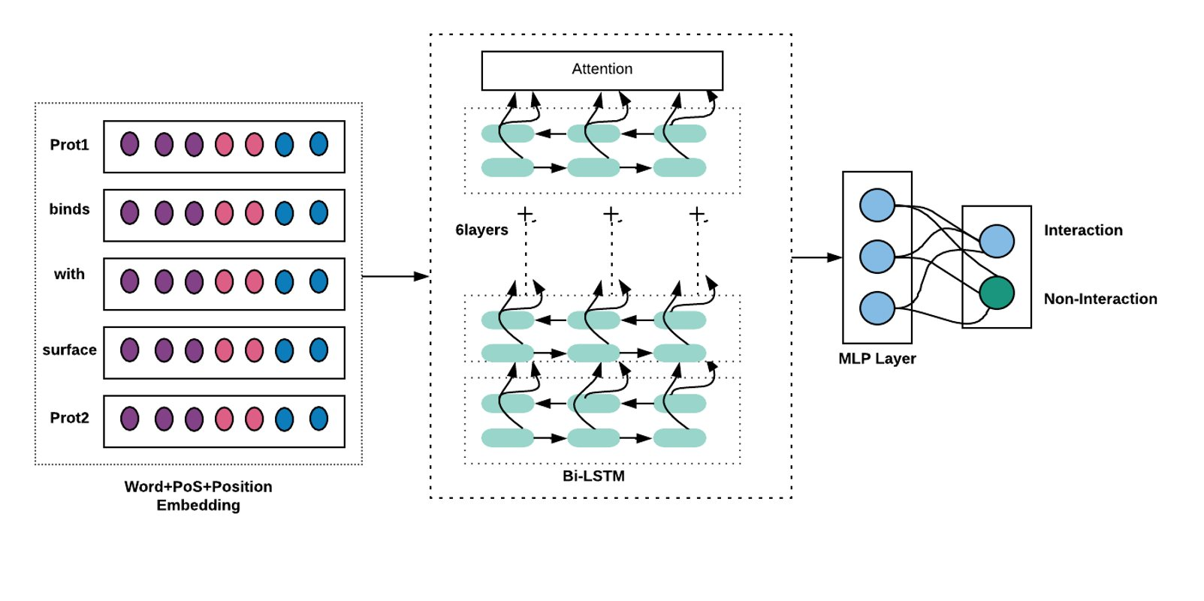
Existing Work on Biomedical Relation Extraction
Idea: label examples, train a deep learning model (LSTM, RNN, GRU)
Success! Much better generalizability
Problem: require labelled data:-(

Slide 21
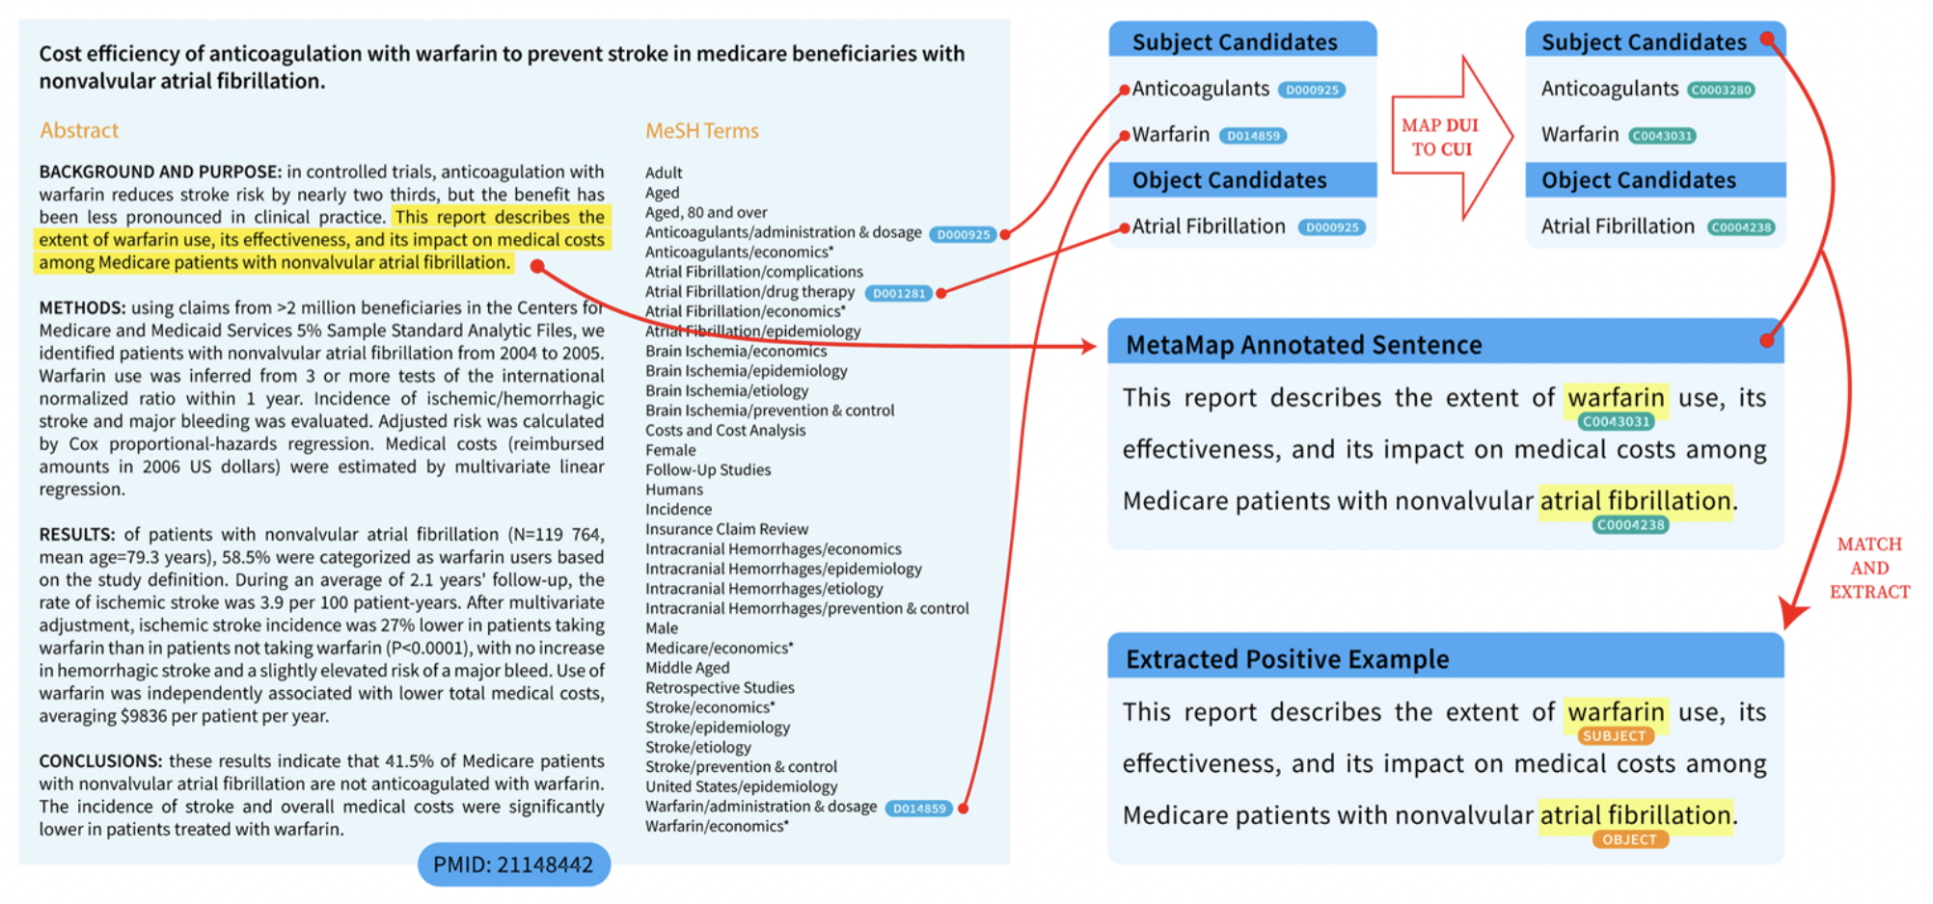
Existing Work on Biomedical Relation Extraction- Distant Supervision
Idea: derive labels from an existing knowledge base (KB)
Assume sentences with related entities are positive examples
Assume sentences with unrelated entities are negative examples
Notes:
DUI – Mesh descriptors; CUI: from UMLS

Slide 22
Distant supervision: limitations
Distant supervision is a powerful idea — but it has two limitations:
Not all sentences with related entities are truly positive examples
Need an existing KB to start from — can’t start from scratch

Slide 23
TEMPORAL RELATIONS in CLINICAL TEXT
(again, thanks to Shweta Yadav & Rochana Chaturvedi)

Slide 24
Knee pain has increased over the last two or three weeks prior to the admission

Slide 25
Knee pain has increased over the last two or three weeks prior to the admission
EVENT
EVENT
EVENT
PROBLEM (e.g., disease, injury)
TREATMENT (e.g., medication, therapeutic procedure)
TEST (e.g., diagnostic procedure, laboratory test)
CLINICAL_DEPT (i.e., the event of being transferred to a department)
EVIDENTIAL (e.g., report, show)
OCCURRENCE (i.e., all other events)

Slide 26
Knee pain has increased over the last two or three weeks prior to the admission
EVENT
TIMEX
EVENT
DATE
TIME
DURATION
FREQUENCY

Slide 27
Knee pain has increased over the last two or three weeks prior to the admission
EVENT
TIMEX
EVENT
BEFORE
AFTER
SIMULTANEOUS
OVERLAP
BEGUN_BY
ENDED_BY
DURING
BEFORE_OVERLAP

Slide 28
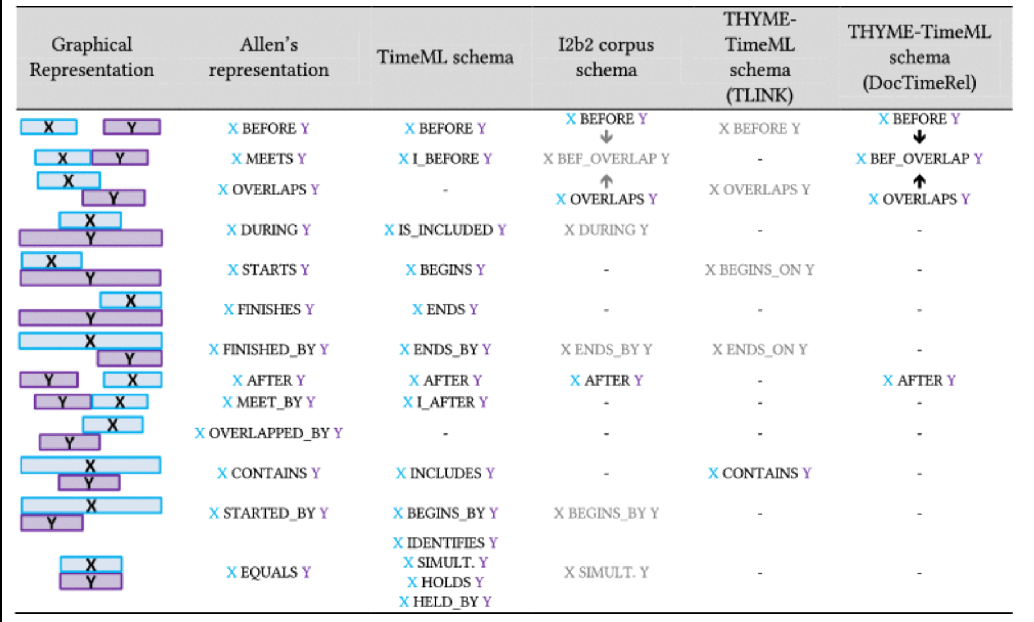
Relazioni temporali
Credit: Y. Bonescki Gumiel, L. Silva e Oliveira, V. Claveau, N. Grabar, E. Cabrera Paraiso, C. Moro,
D. Ribeiro Carvalho. 2021. Temporal Relation Extraction in Clinical Texts: A Systematic Review. ACM Comput. Surv.
54, 7 https://doi.org/10.1145/3462475
Notes:
James Allen. Towards a general theory of action and time. Artificial Intelligence, 23(2), 1984.
James Pustejovsky, Kiyong Lee, Harry Bunt, and Laurent Romary. 2010. ISO-TimeML: An international standard for semantic annotation. In Proceedings of the 7th International Conference on Language Resources and Evaluation (LREC’10).
Weiyi Sun, Anna Rumshisky, and Ozlem Uzuner. 2013. Evaluating temporal relations in clinical text: 2012 i2b2 Challenge. Journal of the American Medical Informatics Association 20, 5 (2013), 806–813. DOI: https://doi.org/10.1136/amiajnl-2013-001628
William F. Styler IV, Steven Bethard, Sean Finan, Martha Palmer, Sameer Pradhan, Piet C de Groen, Brad Erickson, Timothy Miller, Chen Lin, Guergana Savova, and James Pustejovsky. 2014. Temporal annotation in the clinical domain. Transactions of the Association for Computational Linguistics 2 (2014), 143–154 [THYME-TimeML: adaptation of TIME ML to medical domain]

Slide 29
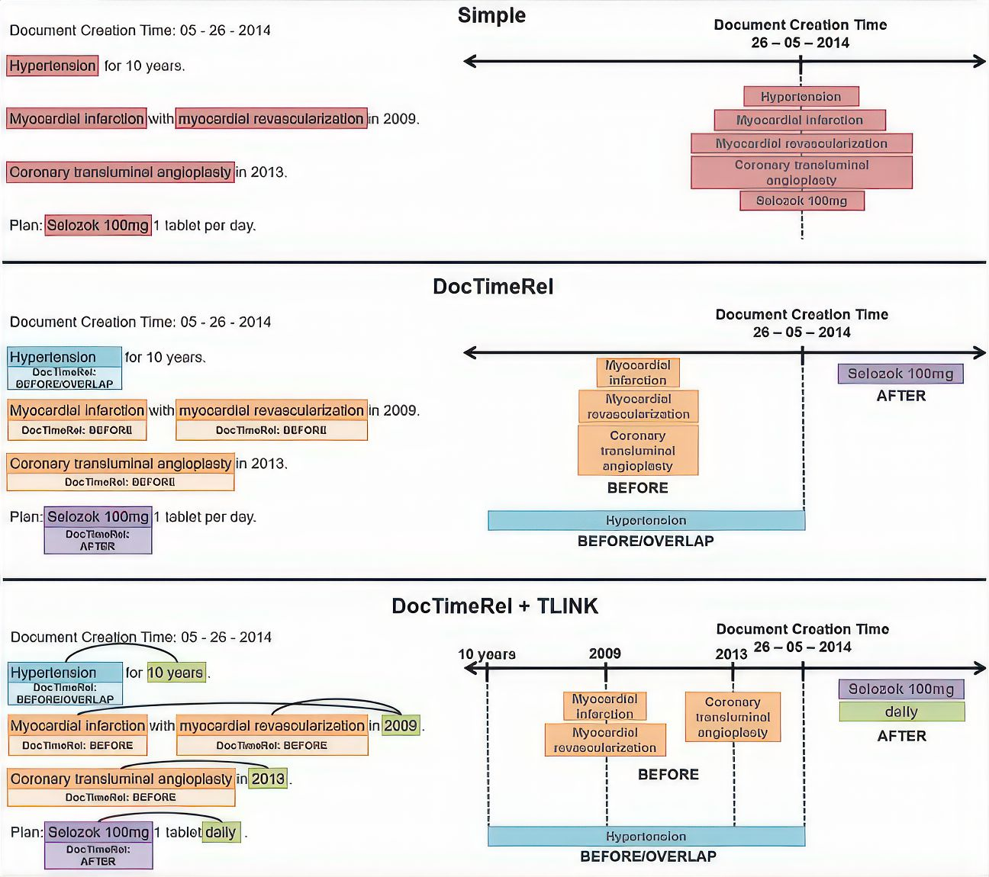
Image: https://dl.acm.org/doi/fullHtml/10.1145/3462475
Notes:
Simple: simply stamp events with document creation time; DocTimeRel: relate events to docRelTime; DocTimeRel+Tlink: they have rels between themselves [Boneski Gumiel et al]

Slide 30
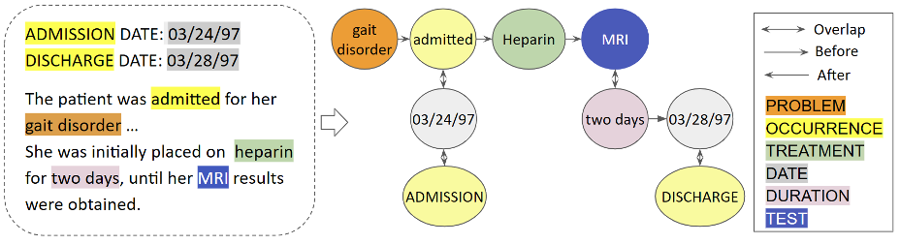
RICONOSCERE RELAZIONI TEMPORALI IN FREE TEXT CLINICAL NOTES

